Slide 1
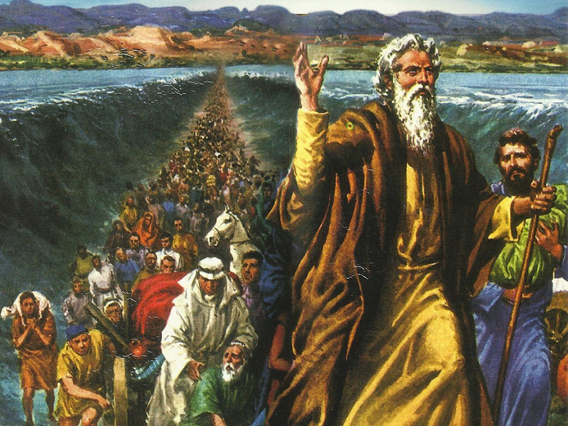
CATECHETICAL TEXTBOOK SERIES OF THE SYRO - MALABAR CHURCH
ON THE PATH OF SALVATION - 5
PEOPLE WHO AWAITED THE REDEEMER
5

Slide 2
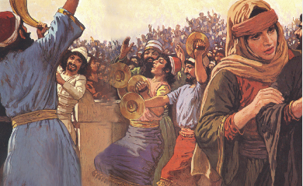
LESSON 11
THE FEASTS OF ISRAEL

Slide 3
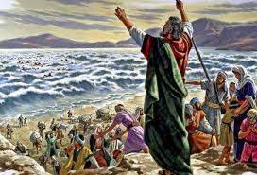
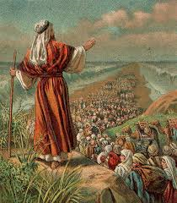
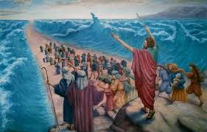
The people of Israel started a happy life in the Land of Canaan.
Canaan , a land full of God’s blessings.
All hardships of People of Israel came to an end, at the end of the
miraculous liberation and long journey from the slavery in Egypt.
People of Israel celebrated various feasts, to commemorate God’s greatness in their life and to ask for God’s forgiveness for their sins.
The festivals reminded the Israelites the important events in the history of salvation.
Celebrations : Loud shout of Joy Trumpet calls Offering of sacrifices

Slide 4
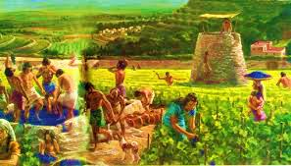
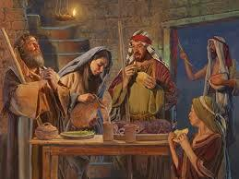
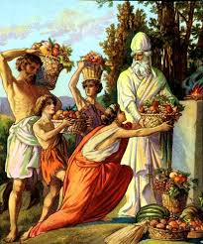
The Feast of Unleavened Bread
Celebrated to thank God. Celebrations started at the beginning of
Harvest and lasted for 7 days.
They cooked and eat Unleavened Bread, made of flour from fresh produce. This feast used to start on the first day after the feast Of Passover. As time passed, they started to celebrate These two feasts together (Lev.23 : 5-8).

Slide 5
The Feast of Passover
A festival to commemorate the miraculous liberation of Israelites
from the slavery of Egypt.
The people of Israel must celebrate the Passover on a fixed schedule. On the fourteenth day of the month, they must celebrate the Passover according to the rules and regulations.

Slide 6

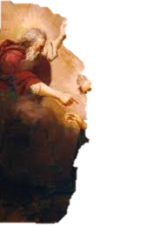
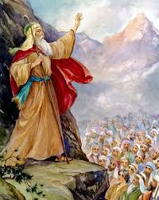
On the 1st month of the 2nd year
after leaving Egypt
Lord told Moses in Mount Sinai
“The people of Israel must celebrate the Passover on a fixed schedule. On the 14th day of the month, they must celebrate the Passover according to the rules and regulations.”

Slide 7

Moses passed on
the words spoken by God to the people of Israel.
Thus they celebrated the Passover in the desert.
Israelites used to have their Passover meal every year
in the evening of the fourteenth day of the first month ,
which is month of Nissan.

Slide 8
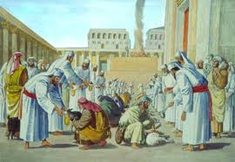
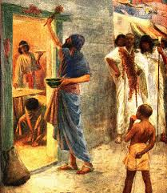
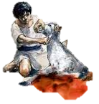
At sunset of the 14th day the lamb was sacrificed.
The lamb for the meal was chosen 4 days earlier.
The cooked meal was eaten with
bitter herbs and Unleavened bread.
The meal was eaten in a hurry.
The blood of the lamb was sprinkled on door posts.

Slide 9
The Festival of Booths
Lord spoke to Moses in
Mount Sinai
“On the 15th day of this 7th month, and lasting for 7 days ,there shall be festival of Booths to the Lord.. For 7 days you shall live in
booths.”

Slide 10
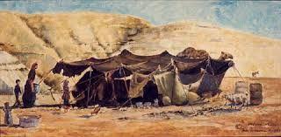
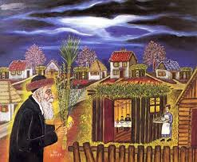
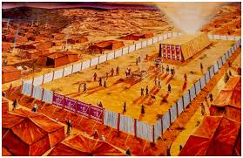
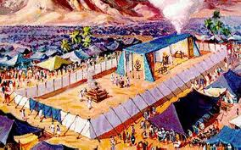
Reminds the stay of Israelites in tents,
when they were brought out of Egypt.
This feast remind your descendants that when I brought the
Israelites out of Egypt, they lived in tents (Lev 23: 33-43).

Slide 11
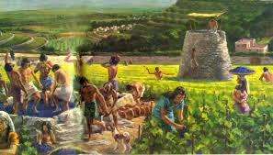
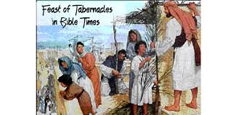
The Festival of Booth - a Harvest festival
They celebrated it by weaving leaves of date palms and trees.
Foreigners, orphans and widows used to participate
in the festival along with family members.
They used to confess their Faith in God who protects them.
During Harvest they made tents or booths
and staying in them they celebrated the festival of Booths.

Slide 12
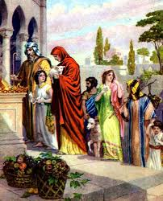
The Feast of Pentecost
Celebrated on the 50th day of the season of harvest.
First fruits of harvest were offered to Lord on this occasion.
The feast also knows as
Festival of weeks
Harvest festival
Festival of first fruits.

Slide 13
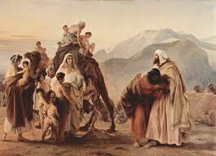
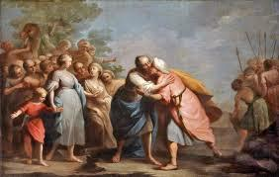
The Day of Atonement
The festival of the Day of Atonement, also is called “Yom Kippur” which is a Hebrew word.
The Hebrew word “Yom Kippur”, reminds one, of the holiness of the Lord as well as the sinfulness of Israel.
The festival of the Day of Atonement, an opportunity to reconcile with others and seek God’s forgiveness.

Slide 14
The Festivals of the Church
Church celebrates many festivals ,which are
  Feasts connected with Jesus
  Feats of Mother Mary
  Feast of Saints
Festival days are
  Holy days
  Celebrates with pomp
  Day to offer our thanks to God
Feast help in our spiritual growth
  When we celebrate them reflecting on the meaning
  Reflecting the message of each of them

Slide 15
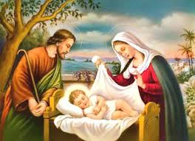
Christmas
Birth of Jesus Christ
Christmas is the feast that reminds people of the birth of Jesus. This commemorates the incarnation of Jesus the son of God who came on earth to bring salvation to manking. Christmas is celebrated, the world over, on 25 December.

Slide 16
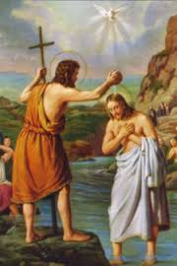
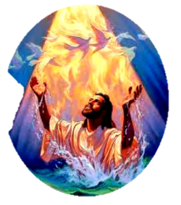
Epiphany
This commemorates the purification of Jesus. The Church celebrates this feast on 6 January.

Slide 17
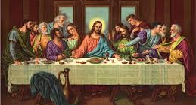
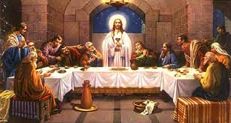
Paschal Feast
This is a very important feast in the Church. The last Supper, which Jesus had eaten with his disciples in the hall of Zion, was the Paschal meal or Passover Weal. The memory of Jesus instituting the Holy Eucharist at the meal is what we celebrate today as the Paschal feast.

Slide 18
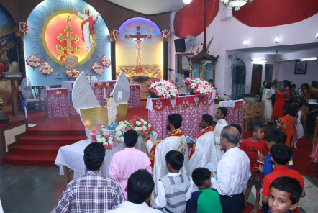
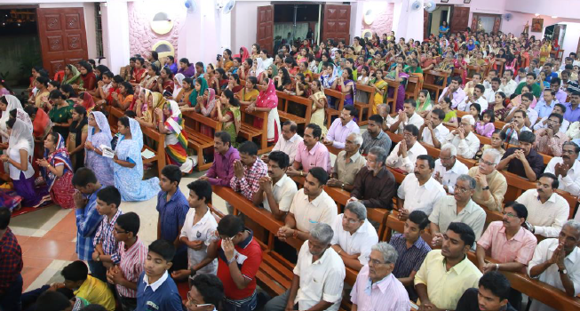
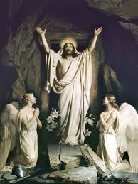
Easter
Easter or the feast of Resurrection is the commemoration of the resurrection of Jesus three days after he was buried following his passion (torture) and crucifixion. This is referred to as the feast. Fifty days of fasting is observed in preparation for Easter is very important as the feast signifies the consummation of God’s plan of salvation.

Slide 19
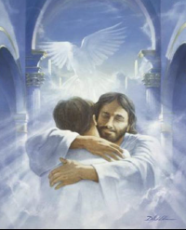
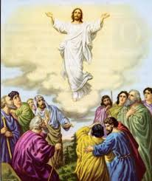
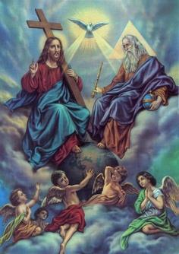
Ascension
Jesus ascended into Heaven 40 days after His resurrection.
Jesus was lifted up into Heaven, while the disciples were watching.
After accomplishing the task, Salvation of humanity.
Jesus went back to Heaven.
Jesus is seated at the right side of His Father.
Feast of ascension reminds us of Jesus
who is preparing a place for us in Heaven.

Slide 20
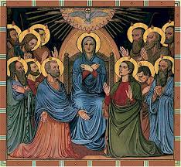
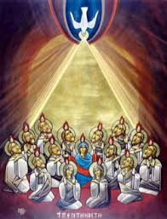
Pentecost
50 days after the resurrection of Jesus
(or 10 days after the ascension of Jesus into Heaven)
Holy Spirit came down, upon the disciples, in the form of tongues of fire.
Pentecost means 50th day.
Church has started functioning as an institution on that day.
Church commemorates its institution on that day.
Feast of Pentecost reminds us of the Holy Spirit being sent to live in and lead the Church.
This feast helps Church and her children to be filled with the divine grace of the Holy Spirit.

Slide 21
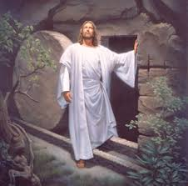
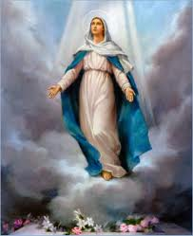
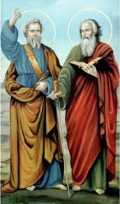
Church celebrates many festivals connected with
Jesus, Mother Mary and Saints.
These feasts are Holy days.
We offer thanks to God by celebrating them with pomp.
Celebration of the feasts by reflecting on the meaning and message of each feast help in our Spiritual Growth.

Slide 22
Let us pray
O Lord! teach us to thank for all the blessing you shower upon us, just as the Israelites recalled your blessings and thanked you.

Slide 23
READ AND RECOUNT
Narrate the celebration of the Pass-over feast among the Israelites. [Exodus 12:21-28].

Slide 24

WORD OF GOD FOR GUIDANCE
Sing to the Lord a new song for hr has done marvellous things [psalm:98:1].

Slide 25
MY DECISION
I would participate with piety in the feast and celebrations of the church

Slide 26
LET US DO
Pair the following
1
2
3
4
5
6
7
1. Pass-over feast
- 50th day
2. Feast of the unlevened bread
- Yom kippur
3. Feast of Booths
- Feast of feasts
4. Feast of Pentecost
- December 25
5. Feast of Reparation of sine
- Beginning of harvest
6. Christmas
- Living in the tents
7. Easter
- Passover

Slide 27
LET US FIND OUT THE ANSWER
1. What did the Israelites commemorate through the feast of Passover?
2. What is the meaning of the word ‘Pentecost’?
3. What for the feast of the reparation of sins was celebrated?
4. Why is Easter known as the feast of feasts?
5. What is the basis of the celebration of the feast of Pentecost in the new testament period?
6. How do the celebrations of feast help us in our spiritual nourishment?

Slide 28
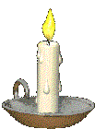


Thank you

